Slide 1
Falls Prevention
Jane Cast Elissa Benson
Neuro Rehabilitation Kent
Notes:
Who we are
What we do
Congrats on attending

Slide 2
Overview
Why is Falls Prevention important?
Causes of Falls
Falls Prevention Strategies
What you can do
Notes:
Timing
What we are going to cover

Slide 3
Why is Falls Prevention important?
Incidence
Cost
Quality of Life
We can do it !
Notes:
Incidence 1 in 3 aged over 65 will fall at least once in a year

Slide 4
Causes of Falls
Physiological
Environmental
Behavioural

Slide 5
Physiological
Ageing Process
Visual impairment
Previous Injury
Cognitive impairment
Long term Conditions
Continence issues
Medication

Slide 6
Environmental
Floor surfaces including rugs, patterned carpets, uneven pavements
Lighting
Noise
People
Distractions
Trip hazards
Slopes, steps, kerbs,

Slide 7
Behavioural
Footwear
Confidence
Posture
Use of walking aids
Speed
Awareness

Slide 8
Falls Prevention
Multifactorial Assessment
Education
Exercise
Environmental control
Behavioural Changes

Slide 9
So what can YOU do ?
Engage
Access Support
Make Changes

Slide 10
What we can offer….
Home visits
Clinic based treatment
Community based input
Long term management
Physiotherapy Assistant
Regular review
Self referral

Slide 11
Evidence Based Exercise Programmes
NICE
Age UK
RCP
Public Health England
Department of Health Prevention package

Slide 12
Key points and recommendations
Tailored to individual
Type/duration /intensity
36 weeks: Class x1 weekly and home based 2 x1 hour sessions
Tai Chi, dancing or gardening
Otago/ FaME exercise programmes
Not all chair based
Balance and strength training

Slide 13
Posture
Stacking
Base of support
Centre of gravity
Head position
Shoulder blades/hands behind back
Leg strength and ankle mobility
Arm position/fixing

Slide 14
Practical session !

Slide 15
Resources
NRK
Sevenoaks Ladies Joggers -Platinum classes
Age UK
Later life training
NHS
Leisure Centres
Personal trainer

Slide 16
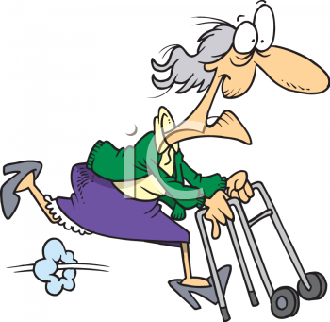
THANK YOU

Slide 17
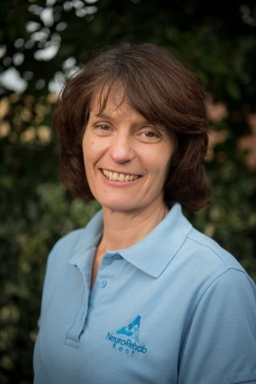
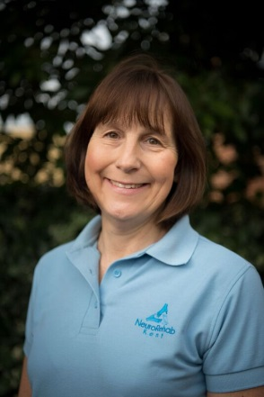
Elissa Benson
Jane Cast
Email: info@neurorehabkent.co.uk
www.neurorehabkent.co.uk
Elissa 01732 357943 0r Jane 01732 451352

